Slide 1










Predicting Customer Churn in Telecom Industry using Power BI and SQL
Presented by Praba Gladish L
Batch code: MBE11

Slide 2


Introduction
Customer Churn Definition: Refers to the rate at which customers discontinue using a company’s services.
Revenue Impact: High churn affects revenue, as acquiring new customers is often more expensive than retaining existing ones.
Strategic Priority: In the competitive telecom industry, customer retention is essential for maintaining profitability and steady revenue streams.
Targeted Retention Strategies:
Analyzing customer segments prone to churn.
Developing strategies to retain high-risk customers, reducing churn-related costs.

Slide 3


Tools Used:
MySQL Workbench
Power BI
Problem Statement:
Predicting Customer Churn in Telecom Industry
Dataset:
https://drive.google.com/file/d/14_KqTbRMWAeMwaWMvPlCSmdgXZKgHy-y/view?usp=sharing

Slide 4
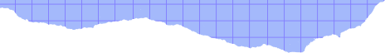
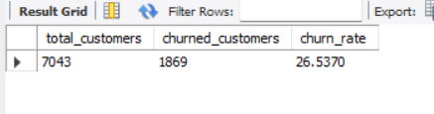
The total number of customers and the churn rate
SELECT COUNT(*) AS total_customers
FROM customer_churn;
SELECT
COUNT(*) AS total_customers,
COUNT(CASE WHEN Customer_Status = 'Churned' THEN 1 END) AS churned_customers
(COUNT(CASE WHEN Customer_Status = 'Churned' THEN 1 END) / COUNT(*)) * 100 AS churn_rate
FROM customer_churn;

Slide 5
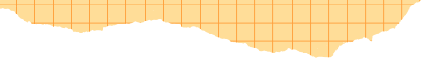
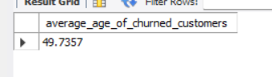

The average age of churned customers
SELECT
AVG(age) AS average_age_of_churned_customers
FROM customer_churn
WHERE Customer_Status = 'Churned';

Slide 6
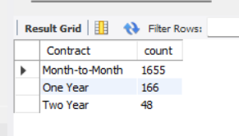
The most common contract types among churned customers
SELECT Contract,
COUNT(*) AS count
FROM customer_churn
WHERE Customer_Status = 'Churned'
GROUP BY Contract
ORDER BY count DESC;

Slide 7
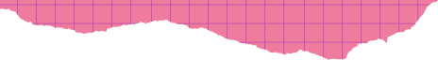
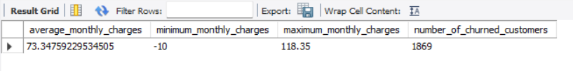
The distribution of monthly charges among churned customers
SELECT
AVG(Monthly_Charge) AS average_monthly_charges,
MIN(Monthly_Charge) AS minimum_monthly_charges,
MAX(Monthly_Charge) AS maximum_monthly_charges,
COUNT(*) AS number_of_churned_customers
FROM customer_churn
WHERE Customer_Status= 'Churned';

Slide 8

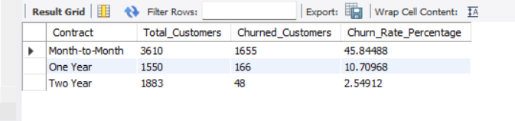
A query to identify the contract types that are most prone to churn
SELECT Contract,
COUNT(*) AS Total_Customers,
SUM(CASE WHEN Customer_Status = 'Churned' THEN 1 ELSE 0 END) AS Churned_Customers,
(SUM(CASE WHEN Customer_Status = 'Churned' THEN 1 ELSE 0 END) * 100.0 / COUNT(*)) AS Churn_Rate_Percentage
FROM customer_churn
GROUP BY Contract
ORDER BY Churn_Rate_Percentage DESC;

Slide 9
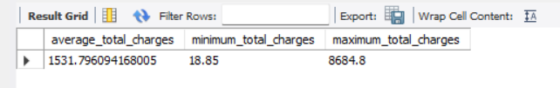
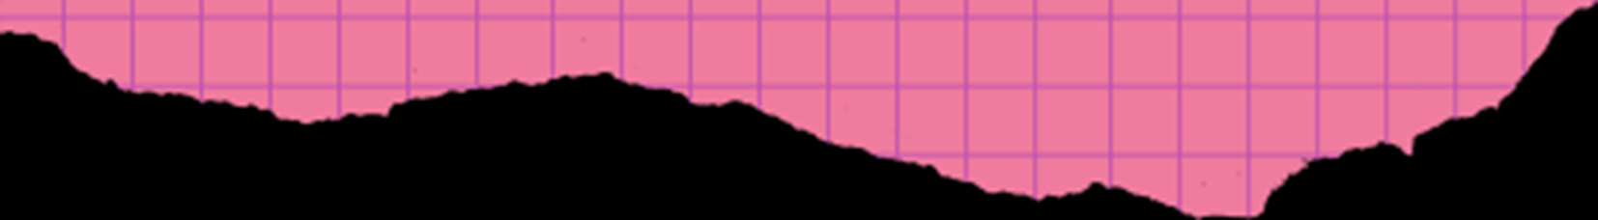
Customers with high total charges who have churned
SELECT
AVG(Total_Charges) AS average_total_charges,
MIN(Total_Charges) AS minimum_total_charges,
MAX(Total_Charges) AS maximum_total_charges
FROM customer_churn
WHERE Customer_Status = 'churned';

Slide 10

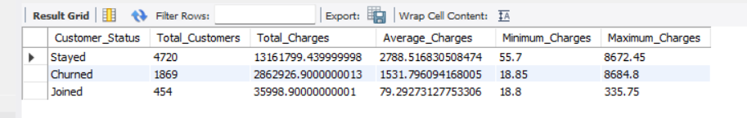
The total charges distribution for churned and non-churned customers
SELECT
Customer_Status,
COUNT(*) AS Total_Customers,
SUM(Total_Charges) AS Total_Charges,
AVG(Total_Charges) AS Average_Charges,
MIN(Total_Charges) AS Minimum_Charges,
MAX(Total_Charges) AS Maximum_Charges
FROM customer_churn
GROUP BY Customer_Status;

Slide 11


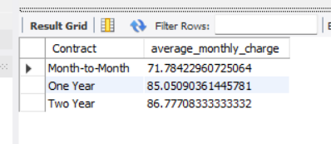
The average monthly charges for different contract types among churned customers
select Contract,
avg(Monthly_charge) as average_monthly_charge
from Customer_churn
where Customer_Status = 'Churned'
group by Contract;

Slide 12

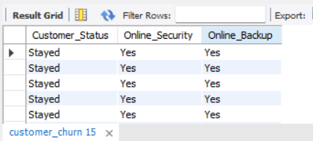
Customers who have both online security and online backup services and have not churned
select Customer_Status, Online_Security,Online_Backup
from customer_churn
where Online_Backup = 'Yes'
And Online_Security = 'Yes'
And Customer_Status in ('Stayed','joined');

Slide 13
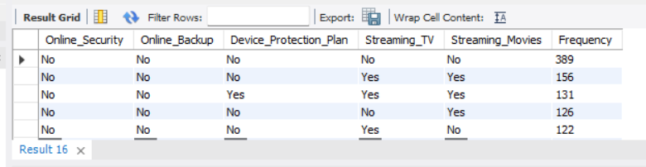
The most common combinations of services among churned customers
SELECT Online_Security, Online_Backup, Device_Protection_Plan, Streaming_TV, Streaming_Movies, COUNT(*) AS Frequency
FROM customer_churn
WHERE Customer_Status = 'Churned'
GROUP BY Online_Security, Online_Backup, Device_Protection_Plan, Streaming_TV, Streaming_Movies
ORDER BY Frequency DESC;

Slide 14

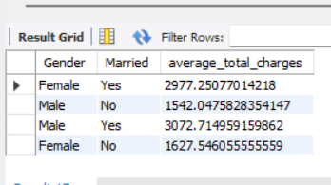
The average total charges for customers grouped by gender and marital status
select Gender,Married,
avg(Total_Charges) as average_total_charges
from Customer_churn
group by Gender, Married

Slide 15
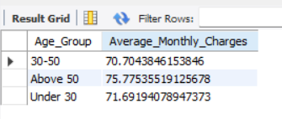
The average monthly charges for different age groups among churned customers
SELECT CASE
WHEN Age < 30 THEN 'Under 30'
WHEN Age BETWEEN 30 AND 50 THEN '30-50'
ELSE 'Above 50'
END AS Age_Group,
AVG(Monthly_Charge) AS Average_Monthly_Charges
FROM customer_churn
WHERE Customer_Status = 'Churned'
GROUP BY Age_Group;

Slide 16
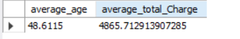
The average age and total charges for customers with multiple lines and online backup
select
avg(Age) as average_age,
avg(Total_Charges) as average_total_Charge
from Customer_churn
where Multiple_lines = 'Yes'
and Online_Backup = 'Yes'

Slide 17
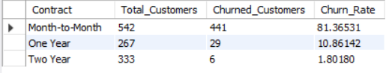
The contract types with the highest churn rate among senior citizens (age 65 and over)
SELECT Contract,
COUNT(*) AS Total_Customers,
SUM(CASE WHEN Customer_Status = 'Churned' THEN 1 ELSE 0 END) AS Churned_Customers,
(SUM(CASE WHEN Customer_Status = 'Churned' THEN 1 ELSE 0 END) * 100.0 / COUNT(*)) AS Churn_Rate
FROM customer_churn
WHERE Age >= 65
GROUP BY Contract
ORDER BY Churn Rate DESC;

Slide 18
The average monthly charges for customers who have multiple lines and streaming TV
SELECT AVG(Monthly_Charge) AS Average_Monthly_Charges
FROM customer_churn
WHERE Multiple_Lines = 'Yes'
AND Streaming_TV = 'Yes';

Slide 19
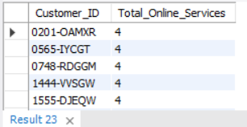
The customers who have churned and used the most online services
SELECT Customer_ID,
(CASE WHEN Online_Security = 'Yes' THEN 1 ELSE 0 END +
CASE WHEN Online_Backup = 'Yes' THEN 1 ELSE 0 END +
CASE WHEN Device_Protection_Plan = 'Yes' THEN 1 ELSE 0 END +
CASE WHEN Premium_Tech_Support = 'Yes' THEN 1 ELSE 0 END) AS Total_Online_Services
FROM customer_churn
WHERE Customer_Status = 'Churned'
ORDER BY Total_Online_Services DESC;

Slide 20
The average age and total charges for customers with different combinations of streaming services
select Streaming_Movies, Streaming_Music, Streaming_TV,
avg(Age) as average_age,
avg(Total_Charges) as average_total_charges
from customer_churn
group by Streaming_Movies,Streaming_Music, Streaming_Tv

Slide 21
The gender distribution among customers who have churned and are on yearly contracts
SELECT Gender, COUNT(*) AS Customer_Count
FROM customer_churn
WHERE Customer_Status = 'Churned'
AND Contract = 'One Year'
GROUP BY Gender;

Slide 22
The average monthly charges and total charges for customers who have churned, grouped by contract type and internet service type
SELECT Contract, Internet_Service,
AVG(Monthly_Charge) AS Average_Monthly_Charges,
AVG(Total_Charges) AS Average_Total_Charges
FROM customer_churn
WHERE Customer_Status = 'Churned'
GROUP BY Contract, Internet_Service;

Slide 23
The customers who have churned and are not using online services, and their average total charges
SELECT AVG(Total_Charges) AS Average_Total_Charges
FROM customer_churn
WHERE Customer_Status = 'Churned'
AND Online_Security = 'No'
AND Online_Backup = 'No'
AND Device_Protection_Plan = 'No'
AND Premium_Tech_Support = 'No';

Slide 24
The average monthly charges and total charges for customers who have churned, grouped by the number of dependents
SELECT Number_of_Dependents,
AVG(Monthly_Charge) AS Average_Monthly_Charges,
AVG(Total_Charges) AS Average_Total_Charges
FROM customer_churn
WHERE Customer_Status = 'Churned'
GROUP BY Number_of_Dependents;

Slide 25

The customers who have churned, and their contract duration in months (for monthly contracts)
SELECT Customer_ID, Tenure_in_Months
FROM customer_churn
WHERE Customer_Status = 'Churned'
AND Contract = 'Month-to-Month';

Slide 26
The average age and total charges for customers who have churned, grouped by internet service and phone service
SELECT Internet_Service, Phone_Service,
AVG(Age) AS Average_Age,
AVG(Total_Charges) AS Average_Total_Charges
FROM customer_churn
WHERE Customer_Status = 'Churned'
GROUP BY Internet_Service, Phone_Service;

Slide 27
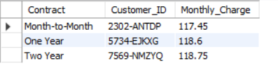
View to find the customers with the highest monthly charges in each contract type
CREATE VIEW highest_monthly_charges ASWITH MaxCharges AS ( SELECT Contract, MAX(Monthly_Charge) AS MaxMonthlyCharge FROM customer_churn GROUP BY Contract)SELECT c.Contract, c.Customer_ID, -- Assuming there's a CustomerID field c.Monthly_ChargeFROM customer_churn cJOIN MaxCharges mc ON c.Contract = mc.Contract AND c.Monthly_Charge = mc.MaxMonthlyCharge;
SELECT Contract, MAX(Monthly_Charge) AS highest_monthly_chargesFROM Customer_churnGROUP BY Contract;

Slide 28
Created a view to identify customers who have churned and the average monthly charges compared to the overall average
CREATE VIEW Churned_Customers_Average_Comparison AS
SELECT Customer_ID, Monthly_Charge,
(SELECT AVG(Monthly_Charge) FROM customer_churn) AS Overall_Average,
Monthly_Charge - (SELECT AVG(Monthly_Charge) FROM customer_churn) AS Difference_From_Average
FROM customer_churn
WHERE Customer_Status = 'Churned';

Slide 29
Created a view to find the customers who have churned and their cumulative total charges over time
CREATE VIEW Cumulative_Total_Charges AS SELECT Customer_ID, Tenure_in_Months, SUM(Total_Charges) AS Cumulative_ChargesFROM customer_churnWHERE Customer_Status = 'Churned'GROUP BY Customer_ID, Tenure_in_MonthsORDER BY Customer_ID, Tenure_in_Months;SELECT * FROM Cumulative_Total_Charges;

Slide 30
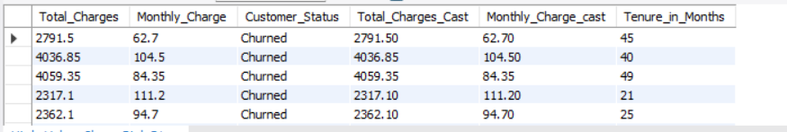
Stored Procedure to Calculate Churn Rate
CREATE VIEW High_Value_Churn_Risk AS
SELECT Total_Charges,Monthly_Charge,Customer_Status,
CAST(Total_Charges AS DECIMAL(10, 2)) AS Total_Charges_Cast,
CAST(Monthly_Charge AS DECIMAL(10, 2)) AS Monthly_Charge_cast,
Tenure_in_Months
FROM customer_churn WHERE CAST(Total_Charges AS DECIMAL(10, 2)) > 2000
AND Customer_Status = 'Churned' AND Tenure_in_Months < 70;

Slide 31
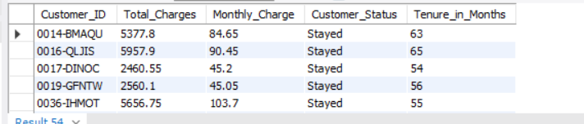
Stored Procedure to Identify High-Value Customers at Risk of Churning
DELIMITER //
PROCEDURE Identify_High_Value_Churn_RiskK()
BEGIN
SELECT Customer_ID, Total_Charges, Monthly_Charge, Customer_Status, Tenure_in_Months
FROM customer_churn
WHERE Total_Charges > 2000
AND Customer_Status != 'Churned'
AND Tenure_in_Months < 70;
END //DELIMITER ;

Slide 32
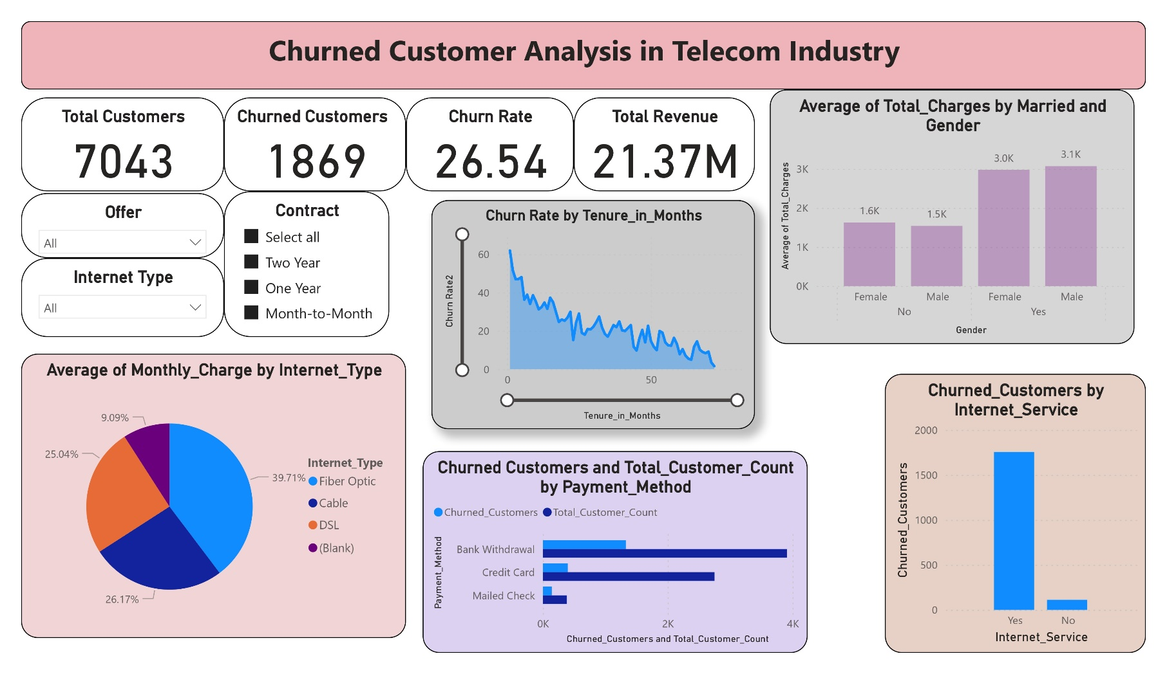

Slide 33
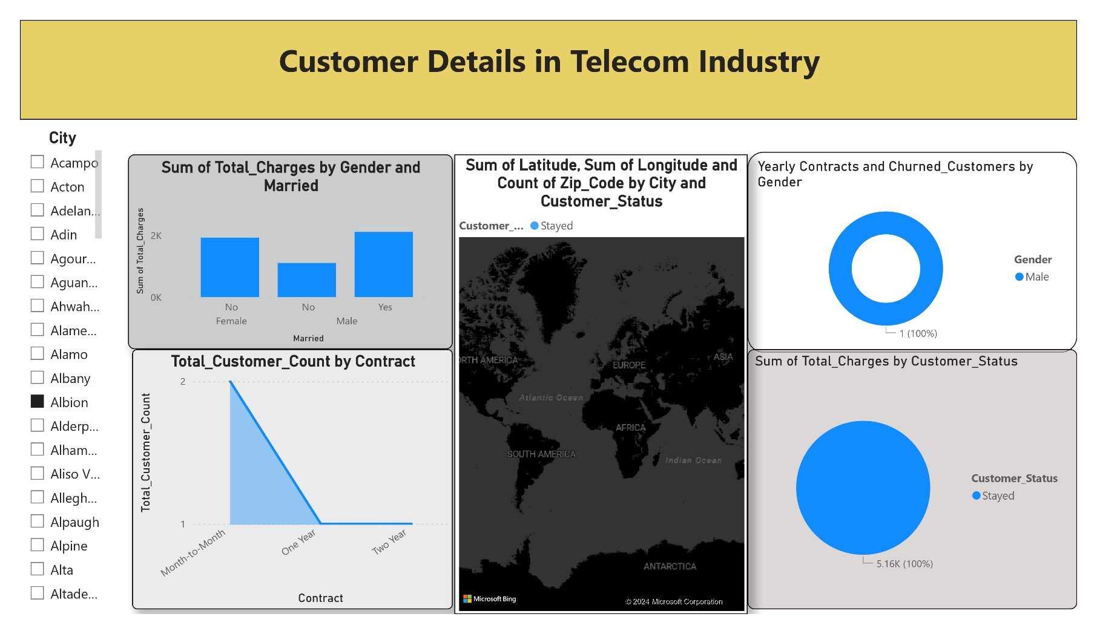

Slide 34
Customer Retention Strategy:
Reducing Churn in Monthly Contracts
Problem: Customers on monthly contracts have a higher risk of churning.
Solution: Introduce a two-year contract option with attractive incentives, encouraging monthly customers to switch to a more stable long-term commitment. Incentives could include discounted rates or additional benefits, lowering their monthly costs.
Expected Impact: This strategy is designed to enhance customer satisfaction, increase loyalty, and reduce churn by providing at-risk customers with a financially appealing, longer-term option.

Slide 35
Customer Retention Solutions
1. Attitude of Service Provider or Support Personnel
Regular customer service training focused on empathy and communication
Post-interaction satisfaction surveys and rewards for positive feedback
2. Competitor Offers (Better Devices, Speed, More Data)
Monitor competitor offerings; adjust pricing/plans as needed
Introduce loyalty programs and device upgrade options for long-term customers

Slide 36

3. Dissatisfaction with Product/Service Quality
Regular network performance assessment and upgrades
Proactive communication on service improvements
4. Extra Charges and High Prices
Transparent billing to reduce hidden fees
Offer budget-friendly and customizable plans

Slide 37
5. Lack of Affordable Download and Upload Speeds
Invest in network infrastructure upgrades
Introduce affordable speed tiers
6. Lack of Self-Service Options on the Web
Enhance online portal with plan management, billing, and troubleshooting
Promote a user-friendly mobile app for easy self-service

Slide 38

7. Limited Services & Long-Distance Charges
Expand service range and introduce nationwide or global plans
Bundle or discount long-distance charges
8. Network Reliability Issues
Strengthen infrastructure to minimize downtime
Proactive maintenance schedules with customer notifications

Slide 39
9. Poor Expertise of Online and Phone Support
Ongoing training and certifications for support teams
Create a customer knowledge base for self-service solutions
10. Price Being Too High
Evaluate competitive pricing models
Offer discounts for loyalty and long-term contracts

Slide 40
11. Accounts of Deceased Customers
Simplify account closure for family members
Provide transfer options if family wishes to continue service

Slide 41
Leveraging Predictive Analysis for Retention
Early Detection: Predictive Analysis identifies early signs of potential churn.
Proactive Interventions: Enables targeted retention efforts before customers leave.
Behaviour Analysis: Understanding customer behaviour helps address issues proactively.
Enhanced Experience: Delivers tailored, positive customer experiences to boost loyalty.

Slide 42
Strategies for Customer Retention
Exceptional Customer Service: Fast, friendly support across multiple channels (call, chat, social).
Personalized Plans: Tailoring plans to usage patterns reduces dissatisfaction.
Loyalty Programs: Rewards, bill discounts, and device upgrades for long-term commitment.
Early-Stage Offers: Mitigates early dissatisfaction with offers in the first 30-120 days.
Clear Activation & Details: Simplified activation and clear plan info enhance onboarding

Slide 43
Enhancing Customer Engagement
Regular Engagement: Shows customers they are valued through consistent interactions.
Personalized Communication: Calls, emails, and messages with offers and support.
Encouraging Loyalty: Personalized engagement helps secure long-term customer relationships.

Slide 44
The Role of AI in the Telecom Industry
Predictive Maintenance: ML algorithms detect patterns to prevent network issues.
Dynamic Resource Allocation: Adjusts resources based on demand spikes.
Automated Traffic Management: AI-based rerouting enhances network performance.

Slide 45
AI-Driven Customer Support
24/7 Support: AI-powered chatbots and virtual assistants for continuous service.
Efficient Service: Quick response for common queries; complex issues go to human agents.
Enhanced Experience: AI-driven support improves customer satisfaction and loyalty.

Slide 46
Conclusion
In this project, I have utilized SQL and Power BI to analyze customer churn in the telecom industry.
I have Used Power BI to identify trends, patterns, and key factors contributing to churn. And developed targeted, data-driven solutions to address specific churn reasons, including service quality, pricing, customer support, and competitive offers.
Created user-friendly, real-time dashboards that provide valuable insights into customer behavior and churn risk.
This project offers actionable insights and effective retention strategies, empowering telecom providers to reduce churn, retain customers, and maintain a steady revenue stream.

